Slide 1
Mutable Data

Slide 2
Local states for compound objects
Compound data is used as a means for constructing computational objects that have several parts.
Data abstraction, provided constructors to create data objects, and selectors, to access the parts of compound data objects.
With the introduction of local state variables & variables, one may desire to change state of a compound data object.

Slide 3
Mutators
Data abstraction along with original constructor and selectors, include additional primitive procedures to modify data objects, named ‘mutators’.
Data objects for which mutators are defined as called as ‘mutable data objects.’

Slide 4
Mutable Lists
Along with ‘cons’, ‘car’, ‘cdr’, ‘list’ and ‘append’, few additional operations have been defined on Lists.
(set-car! x y) : It modifies the pair by replacing the car pointer of x by a pointer to the second argument (y) of set-car!
works with #lang sicp

Slide 5
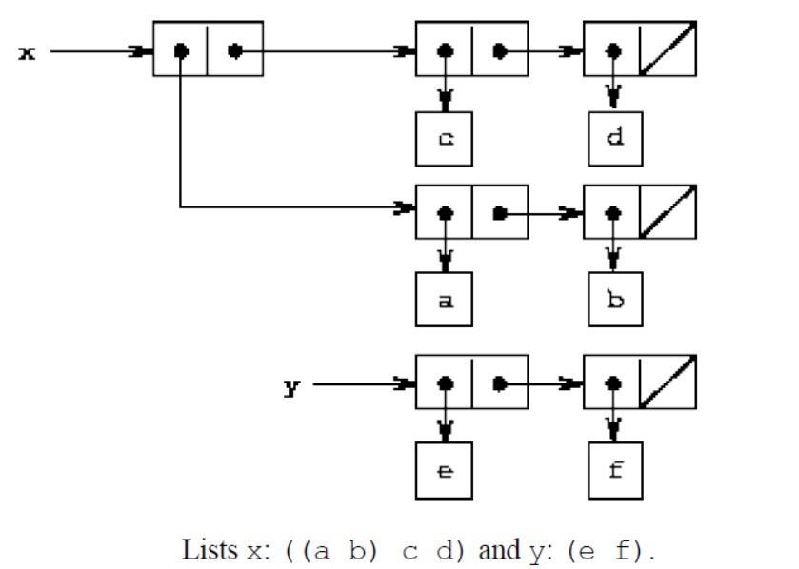
Mutable Lists
(set-car! x y) : It modifies the pair by replacing the car pointer of x by a pointer to the second argument (y) of set-car!

Slide 6
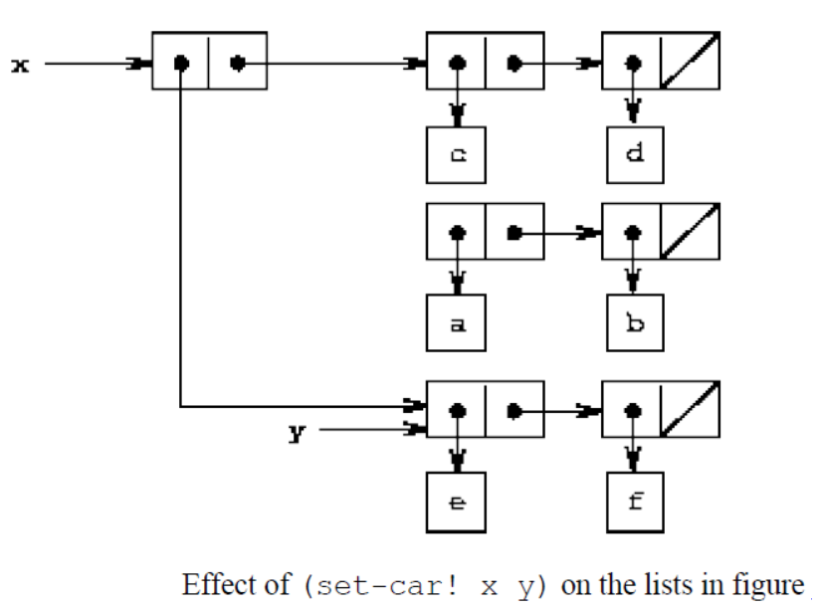
Mutable Lists
(set-car! x y) : It modifies the pair by replacing the car pointer of x by a pointer to the second argument (y) of set-car!
Changed pointer od car part of ‘x’

Slide 7
Mutable Lists
(set-car! x y) : It modifies the pair by replacing the car pointer of x by a pointer to the second argument (y) of set-car!
(set-cdr! x y) : It modifies the pair by replacing the cdr pointer of x by a pointer to the second argument (y) of set-cdr!

Slide 8
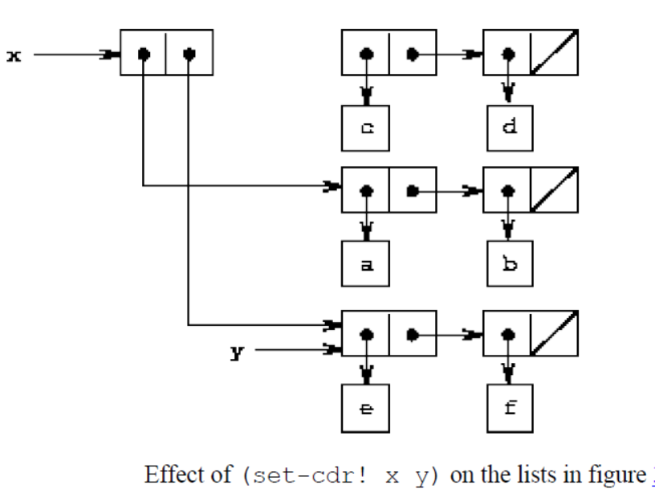
Mutable Lists
(set-cdr! x y) : It modifies the pair by replacing the cdr pointer of x by a pointer to the second argument (y) of set-cdr!

Slide 9
Append lists using mutators
Original append procedure
append procedure
List x={1,2,3} List y={4 5 6}
(define (append x y)
(if (null? x)
y
(cons (car x) (append (cdr x) y))))

Slide 10
Append lists using mutators
New append procedure
List x={1,2,3} List y={4 5 6}
(define (append! x y)
(set-cdr! (last-pair x) y)
x)
(define (last-pair x) --------{3}➔ {3 {}}
(if (null? (cdr x))
x
(last-pair (cdr x))))

Slide 11
Append lists using mutators
New append procedure
List x={1,2,3} List y={4 5 6}
(append listx listy)= {1 2 3 4 5 6}
(append! listx listy)={1 2 3 4 5 6}
(append ‘() listy)=?
(append! ‘() listx)=?

Slide 12
Append lists using mutators
New append procedure
List x={1,2,3} List y={4 5 6}
(append listx listy)=‘(1 2 3 4 5 6)
(append! listx listy)= ‘(1 2 3 4 5 6)
(append ‘() listy)= (4 5 6)
(append! ‘() listx)= ERROR.

Slide 13
Append lists using mutators
(define x (list 'a 'b))
(define y (list 'c 'd))
(define z (append x y))
z ={a b c d}
(cdr x) = (b)
(define w (append! x y))
w= {a b c d}
(cdr x)={b c d}

Slide 14
Append lists using mutators
It only appends the list in the output. Does not modify any of the pointers
(define x (list 'a 'b))
(define y (list 'c 'd))
(define z (append x y))
z = (a b c d)
(cdr x) = (b)
(define w (append! x y))
w= (a b c d)
(cdr x) = (b c d)
Set-cdr! Modifies the pointer od the cdr part of x

Slide 15
Make-cycle using mutators
(define (make-cycle x)
(set-cdr! (last-pair x) x)
x)
(define z (make-cycle (list 'a 'b 'c))) =?
What happens if we try to compute (last-pair z)?

Slide 16
Make-cycle using mutators
(define (make-cycle x)
(set-cdr! (last-pair x) x)
x)
(define z (make-cycle (list 'a 'b 'c))) =
#0=(a b c . #0#)
What happens if we try to compute (last-pair z)?
Infinite loop

Slide 17
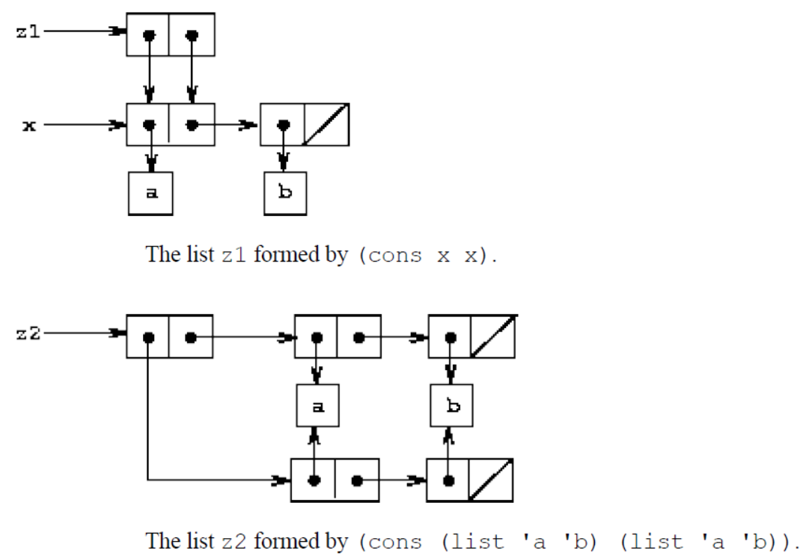
Sharing
(define x (list 'a 'b))
(define z1 (cons x x))

Slide 18
Sharing
(define z2 (cons
(list 'a 'b) (list 'a 'b)))

Slide 19
Sharing and Identity
(define (set-to-wow! x)
(set-car! (car x) 'wow)
x)
z1
((a b) a b)
(set-to-wow! z1) =?
z2
((a b) a b)
(set-to-wow! Z2)=?

Slide 20
Sharing and identity
(define (set-to-wow! x)
(set-car! (car x) 'wow)
x)
z1
((a b) a b)
(set-to-wow! z1)= ((wow b) wow b)
z2
((a b) a b)
(set-to-wow! z2)=((wow b) a b)

Slide 21
Sharing and identity
(eq? (car z1) (cdr z1)) = true
(eq? (car z2) (cdr z2)) =false
Eq? compares two symbols or we can say it compares the respective pointers.

